Slide 1
Employment Success at Every Education Level: Building Career Pathways for every Student
Luke Greiner
Regional Labor Market Analyst
Department of Employment and Economic Development
Labor Market Information Office
http://mn.gov/deed/data/

Slide 3
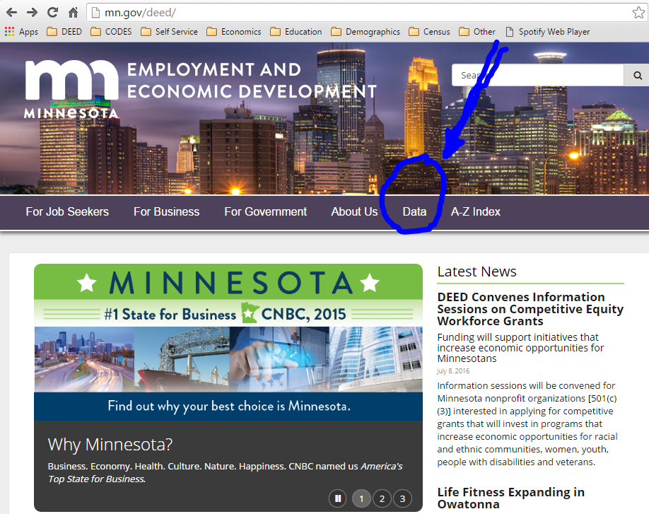
http://mn.gov/deed/

Slide 4
Reality Check!
What is the most demanded job in our region (9)?
What industry has the most jobs in your region?
What percent of job openings in your region (EDR8) require post-secondary education?
Personal Care Aides, or PCA’s
Manufacturing, 19,103 jobs
40% (2nd Qtr. 2016 Job Vacancy Survey), its typically closer to 23-26%
Notes:
Mfg. = 18.4% of all jobs

Slide 5
Lets get Nerdy for a Minute
Industry Employment Statistics, 2015
Region 9 | 2015 Annual Data |  |  |  | 2010-2015 |  | 2014-2015
NAICS Industry Title | Number of Firms | Number of Jobs | Total Payroll ($1,000s) | Avg. Annual Wage | Change in Jobs | Percent Change | Change in Jobs | Percent Change
Total, All Industries | 6,378 | 103,934 | $4,067,781 | $39,104 | 4,190 | 4.2% | 1,420 | 1.4%
Agriculture, Forestry, Fish & Hunt | 308 | 3,130 | $130,804 | $41,652 | 576 | 22.6% | 92 | 3.0%
Mining | 9 | 269 | $19,531 | $72,696 | 43 | 19.0% | 10 | 3.9%
Construction | 775 | 4,766 | $232,723 | $48,672 | 759 | 18.9% | 309 | 6.9%
Manufacturing | 353 | 19,103 | $931,441 | $48,724 | 800 | 4.4% | 252 | 1.3%
Utilities | 38 | 489 | $40,633 | $83,148 | -29 | -5.6% | -19 | -3.7%
Wholesale Trade | 307 | 3,816 | $208,109 | $54,444 | -147 | -3.7% | 16 | 0.4%
Retail Trade | 836 | 12,639 | $284,518 | $22,464 | 710 | 6.0% | 241 | 1.9%
Transportation & Warehousing | 369 | 3,619 | $133,495 | $36,764 | 511 | 16.4% | 267 | 8.0%
Information | 100 | 2,224 | $107,430 | $48,308 | 103 | 4.9% | -18 | -0.8%
Finance & Insurance | 406 | 2,892 | $164,709 | $56,940 | -72 | -2.4% | -48 | -1.6%
Real Estate & Rental & Leasing | 175 | 811 | $22,384 | $27,560 | 10 | 1.2% | 13 | 1.6%
Professional & Technical Services | 343 | 2,578 | $135,613 | $52,676 | 300 | 13.2% | 153 | 6.3%
Management of Companies | 33 | 914 | $92,209 | $100,724 | -134 | -12.8% | -91 | -9.1%
Admin. Support & Waste Mgmt. Svcs. | 209 | 2,494 | $66,286 | $26,520 | 6 | 0.2% | -121 | -4.6%
Educational Services | 120 | 9,295 | $374,830 | $40,456 | 47 | 0.5% | 75 | 0.8%
Health Care & Social Assistance | 595 | 17,623 | $708,139 | $40,144 | 148 | 0.8% | 28 | 0.2%
Arts, Entertainment, & Recreation | 124 | 1,081 | $12,664 | $11,700 | 118 | 12.3% | 36 | 3.4%
Accommodation & Food Services | 452 | 7,661 | $95,863 | $12,480 | 307 | 4.2% | 130 | 1.7%
Other Services | 548 | 3,018 | $76,327 | $25,272 | 78 | 2.7% | 12 | 0.4%
Public Administration | 282 | 5,506 | $230,075 | $41,808 | 56 | 1.0% | 80 | 1.5%
Source: DEED Quarterly Census of Employment & Wages (QCEW) program

Slide 6
Considering College
Higher Education is extremely important for some jobs (think nurse, doctor, accountant)
For other jobs higher education is much less of a requirement (think sales representative truck driver, welder, or customer service representative)
Decisions about higher education should be focused on the end goal (career).

Slide 7
Sizing up the options
Graduate High School Yay!
Start Making Money Later
Start Making Money Now
Job, Apprenticeship, or Military
COLLEGE
Technical College
(6 months-2 years)
University
(4 years or more)
Job

Slide 8
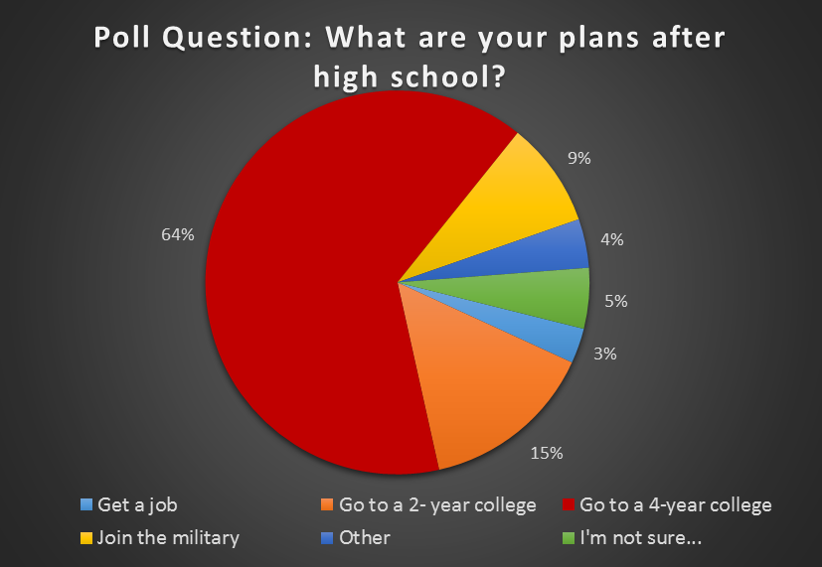
Notes:
Students surveyed were roughly 2,000 10th graders who participated at the SW Career Expo in Worthington and Marshall in October, 2016.

Slide 9
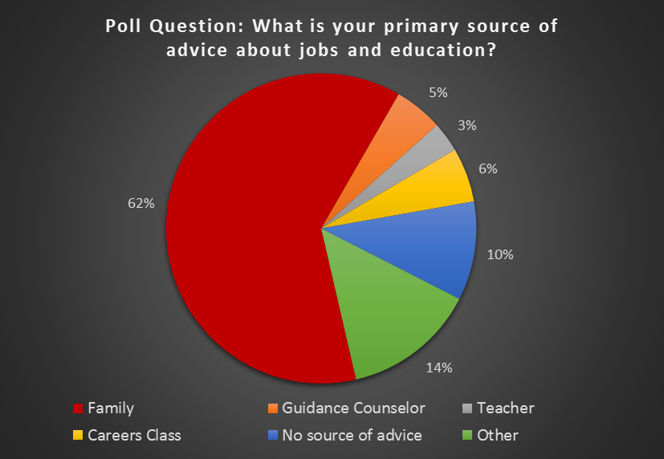

Slide 10
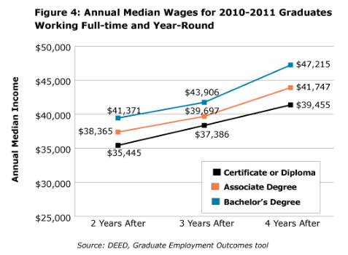
http://mn.gov/deed/newscenter/publications/trends/september-2016/what-to-know.jsp
Notes:
What does this graph, that you’ve most likely seen, suggest is your best way to achieve financial success?
Why can this graphic be an incredibly flawed, and oversimplified way to approach educational decisions?

Slide 11
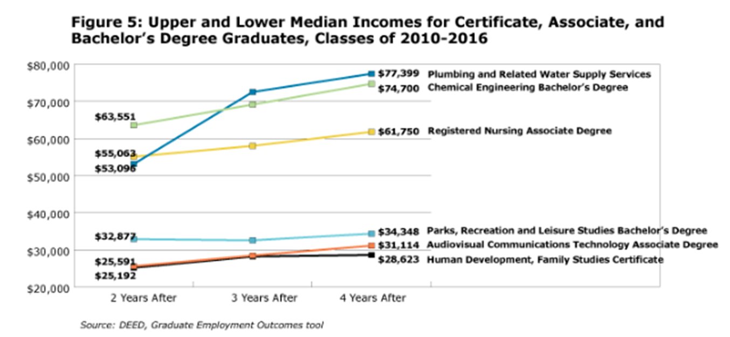
Major Matters.

Slide 13
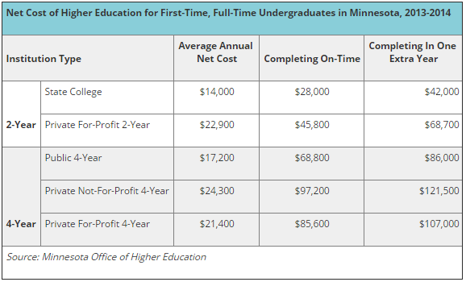
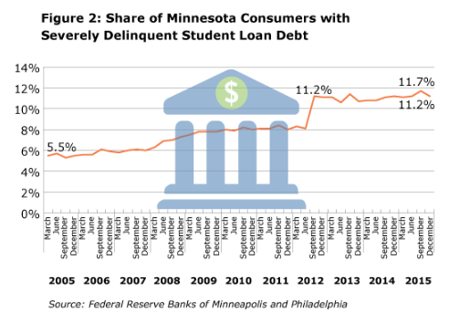
Notes:
This emphasizes the need to complete more research before investing. Class availability and pre-requisites can add up.
Education is too costly for most to wait until they are enrolled to figure out why they are in college. A student who knows why they are in college can develop a better strategy and achieve a better ROE.

Slide 14
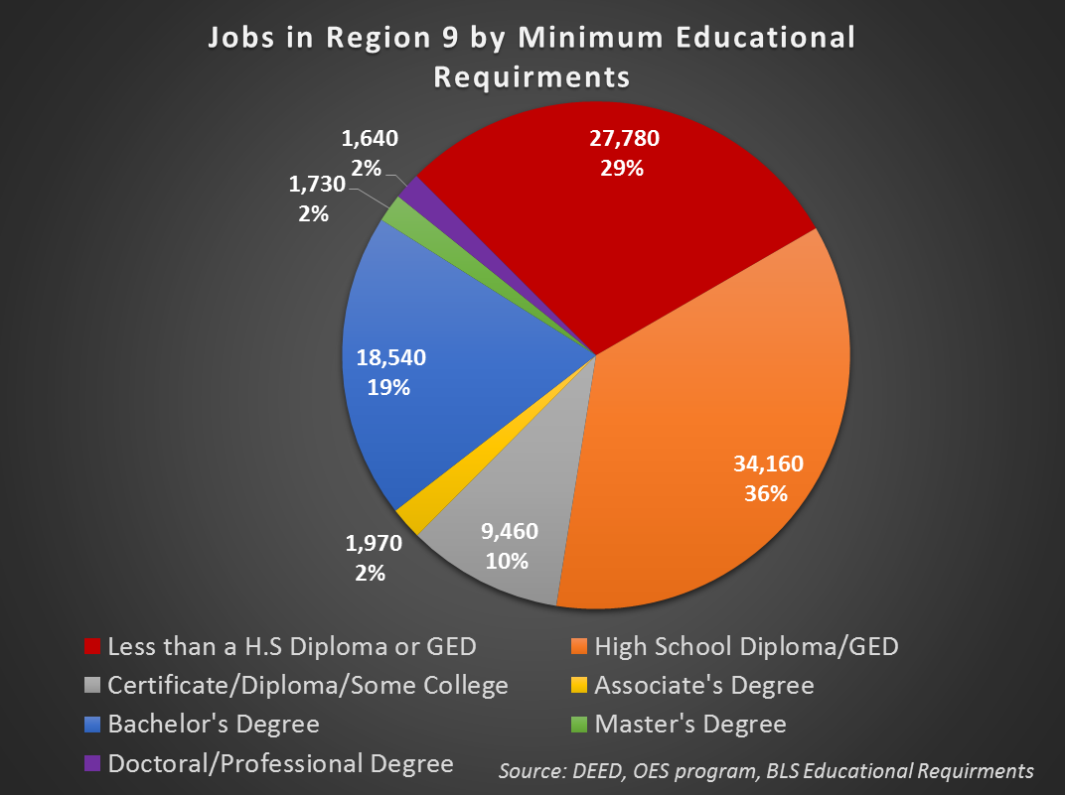

Slide 15
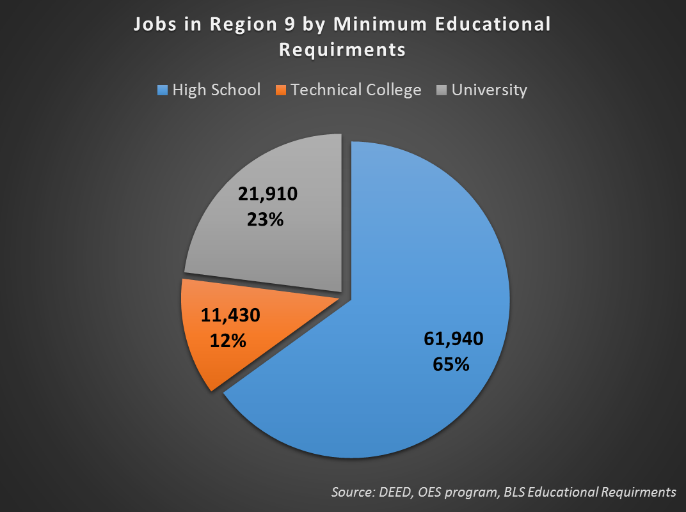

Slide 16
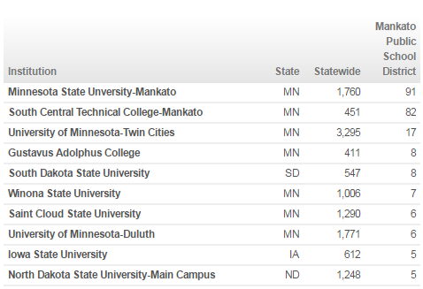
Mankato School District
If 64% of Southwest MN 10th graders plan on going to a four year college, how many actually did?
69% of the entire class of 2014 enrolled in higher education in the fall.
Of those enrolled, 53% enrolled in a 4- Year.(41% for MN)
85% had either graduating or were continuing their education by the 2nd academic year. (Class of 2013)
91 attended Mankato State, 82 attended South Central
Notes:
This doesn’t count the 19% of Mankato students who attended outside of MN.

Slide 17
Employment Outcomes for Mankato State University College Graduates (2012-2013 Class)
Most popular program was Registered Nursing. 208 students graduated with 186 reporting wages 24 months after completion.
2- years after graduating 47% were working FT and YR earning a median annual wage of $60,019. 48.3% found employment in Twin Cities
The second most popular program was the criminal justice and corrections Bachelor’s degree
127 graduates with reported wages, have a median wage of $35,315, 2- years after completion

Slide 18
Regional Occupations in Demand, 2016
Region 9
Less than High School | High School or Equivalent | Some College or Assoc. Degree | Bachelor’s Degree or Higher
Personal Care Aides | First-Line Supervisors of Retail Sales Workers | Nursing Assistants | Sales Managers
$25,098 | $34,209 | $25,136 | $95,718
Food Prep & Serving Workers | Welders, Cutters, Solderers, & Brazers | Heavy & Tractor-Trailer Truck Drivers | Accountants & Auditors
$19,090 | $37,964 | $37,196 | $60,471
Home Health Aides | Secretaries & Administrative Assistants | Registered Nurses | Industrial Engineers
$22,896 | $35,541 | $55,837 | $72,620
Cooks, Restaurant | Office Clerks, General | Licensed Practical & Licensed Voc. Nurses | Elementary & Secondary School Teachers
$19,930 | $30,173 | $41,577 | $48,572
Stock Clerks & Order Fillers | Customer Service Representatives | Computer User Support Specialists | Network & Computer Systems Administrators
$21,830 | $31,269 | $42,052 | $62,067
Janitors & Cleaners | Bus Drivers, School or Special Client | HVAC Mechanics | Financial Managers
$24,723 | $27,018 | $47,356 | $95,820
Laborers & Freight, Stock & Material Movers | Light Truck or Delivery Services Drivers | Teacher Assistants | Physician Assistants
$28,992 | $33,533 | $26,098 | $102,714
Waiters & Waitresses | Team Assemblers | Hairdressers, Hairstylists, & Cosmetologists | Child, Family, & School Social Workers
$18,606 | $30,567 | $24,062 | $51,702
Retail Salespersons | Social & Human Service Assistants | Industrial Engineering Technicians | Industrial Production Managers
$20,298 | $40,679 | $45,750 | $78,204
Cashiers | Maintenance & Repair Workers, General | Computer Network Support Specialists | Clinical, Counseling, & School Psychologists
$19,248 | $38,534 | $54,577 | $59,020
Source: DEED Occupations in Demand

Slide 19
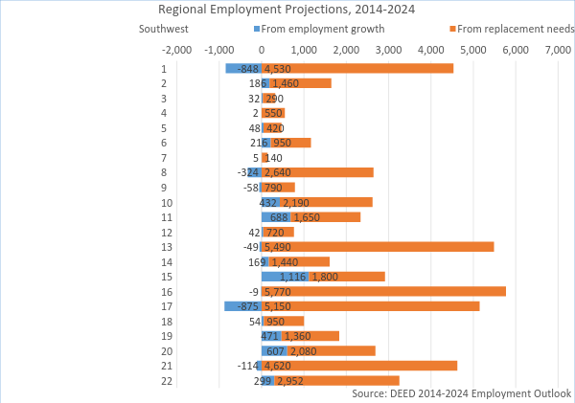

Slide 20
THANK YOU!
Local Look Regional Blog
Monthly blog covering regional economic trends
Workforce insights. Occupations In Demand, Unemployment Rates
Minnesota Economic TRENDS
Quarterly magazine on economic topics
Subscriptions available free of charge or on-line
Minnesota Employment REVIEW
Monthly magazine on economic data and regional trends
Includes Minnesota business development
Available exclusively on-line
http://mn.gov/deed/data/locallook/
http://mn.gov/deed/trends
http://mn.gov/deed/review

Slide 21
Let me know how I can help
Luke Greiner
Regional Labor Market Analyst
Central and Southwest Minnesota
Labor Market Information Office
Phone: (320)-308-5378
Luke.greiner@state.mn.us

